Slide 1

AWS Introduction
Release 07.07.2022/v2

Slide 2
About Accrete.ai
Founded in 2017 and headquartered in Lower Manhattan, Prashant Bhuyan (Founder, CEO and Chairman ) Andres Diana (Chief Product Officer)
Accrete’s continuously learning AI platform transforms under-utilized data and expertise into artificial intelligence. Accrete boosts ROI by increasing efficiency and producing novel profit centers.
Specialties
Financial Services,
Artificial Intelligence & APIs,
Collective Intelligence & Contextual Awareness,
Financial Markets,
Healthcare & Biotechnology,
Dynamic Continuous Learning

Slide 3
Several Historical Trends
Shared Utility Computing - 1960s – MULTICS – Concept of a Shared Computing Utility - 1970s – IBM Mainframes – rent by the CPU-hour. (Fast/slow switch.) Data Center Co-location - 1990s-2000s – Rent machines for months/years, keep them close to the network access point and pay a flat rate. Avoid running your own building with utilities! Pay as You Go - Early 2000s - Submit jobs to a remote service provider where they run on the raw hardware. Sun Cloud ($1/CPU-hour, Solaris +SGE) IBM Deep Capacity Computing on Demand (50 cents/hour) Virtualization - 1960s – OS-VM, VM-360 – Used to split mainframes into logical partitions. - 1998 – VMWare – First practical implementation on X86, but at significant performance hit. - 2003 – Xen paravirtualization provides much perf, but kernel must assist. - Late 2000s – Intel and AMD add hardware support for virtualization.

Slide 4
Cloud* Allows for the Scale of Abstraction to Increase Over Time
Run one process within certain resource limits. Op Sys has virtual memory, virtual CPU, and virtual storage (file system).
Run multiple processes within certain resource limits. Resource containers (Solaris), virtual servers (Linux), virtual images (Docker)
Run an entire operating system within certain limits. Virtual machine technology: VMWare, Xen, KVM, etc.
Run a set of virtual machines connected via a private network. Virtual networks (SDNs) provision bandwidth between virtual machines.
Run a private virtual architecture for every customer. Automated tools replicate virtual infrastructure as needed.

Slide 5
Terminology
Instance = One running virtual machine.
Instance Type = hardware configuration: cores, memory, disk.
Instance Store Volume = Temporary disk associated with instance.
Image (AMI) = Stored bits which can be turned into instances.
Key Pair = Credentials used to access VM from command line.
VPC = Logical isolated section of AWS cloud & virtual network defined by customer
Region = Geographic location, price, laws, network locality.
Availability Zone = Subdivision of region the is fault-independent.

Slide 6
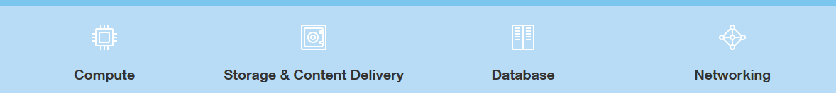
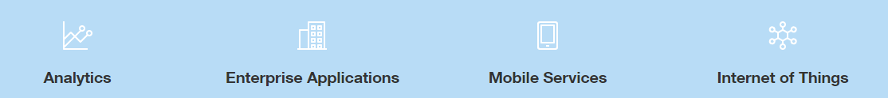
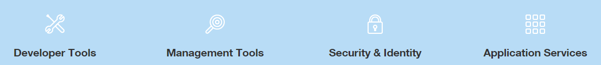
Introduction to AWS
AWS is a secure cloud platform with more than 165 different services that include solutions for:
AWS Global Infrastructure

Slide 7
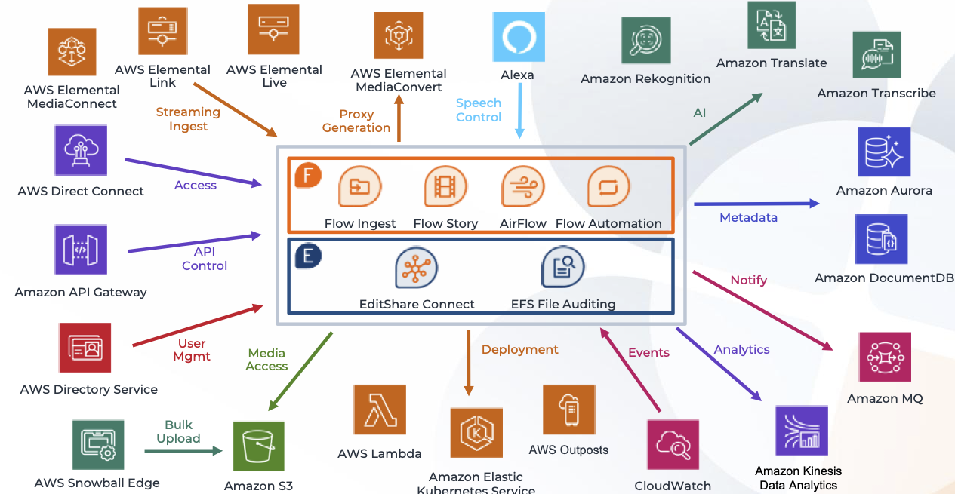
Introduction to AWS contd.

Slide 8
Introduction to AWS contd.
On-demand Delivery of IT resources with pay as you pricing.
AWS Data Centers are Distributed Worldwide
Shared and Dedicated Resources
Benefits of AWS Cloud:
Usage of resources are shared amount several account holders which are isolated from eachother.
The more you use the more you pay, the less you use the less you pay and if you dont use you no need to pay. You can pay per Hour, Minute and Second. Even few services in AWS can charge for Millisecond.
Organized into product categories (Ex. Compute , Storage , Database , IOT etc.. )
No up front cost
Reduced maintenance and Admin Costs
On-Premise VS cloud
Benefits of Setting up Ecommerce website on AWS compared to On-Premises

Slide 9
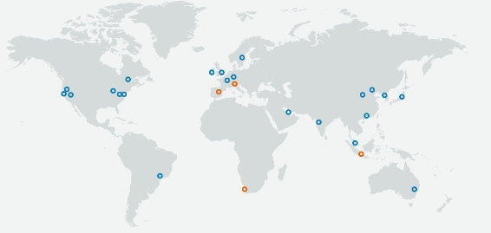
AWS Global Infrastructure
AWS now spans 69 Availability Zones within 22 geographic regions around the world, and has announced plans for thirteen more Availability Zones and four more AWS Regions in Indonesia, Italy, South Africa, and Spain.
Visit this link for more Info: https://aws.amazon.com/about-aws/global-infrastructure/

Slide 10
What can you do on cloud?
You can use a cloud computing platform for:
Application Hosting
Backup and Storage
Content Delivery
Websites
Enterprise IT
Databases

Slide 11






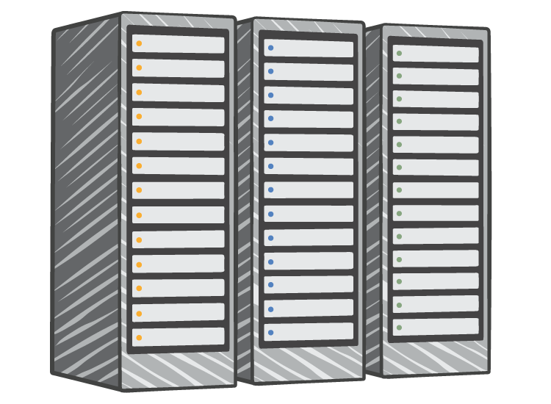




On-premise vs AWS
On-Premises Infrastructure
Amazon Web Services
Security
Firewalls
ACLs
Administrators
Security Groups
Network Access Control Lists
Identity Access Management
Networking
Network
Router
Network Pipeline
Switch
Elastic Load Balancing
Amazon VPC
On-Premises Servers
Servers
VPC
Amazon Machine Image
Amazon EC2 Instances
DAS
SAN
NAS
Storage and Database
RDBMS
Elastic Block Store
Elastic File System
Amazon S3
Amazon RDS

Slide 12
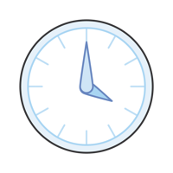



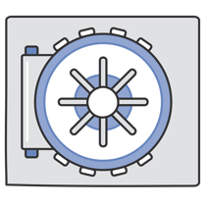
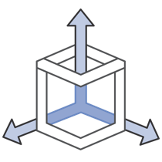
Why Do DevOps Love AWS?
Time to Develop & Manage
Access
infrastructure in minutes
Low Cost
Pay-as-you-go pricing
Elastic
Easily add or remove capacity
Globally Accessible
Easily Collaborate with
researchers around the world
Secure
A collection of tools to
protect data and privacy
Scalable
Access to effectively
limitless capacity

Slide 13
Some Core Concepts
Understanding the different services offered by AWS

Slide 14
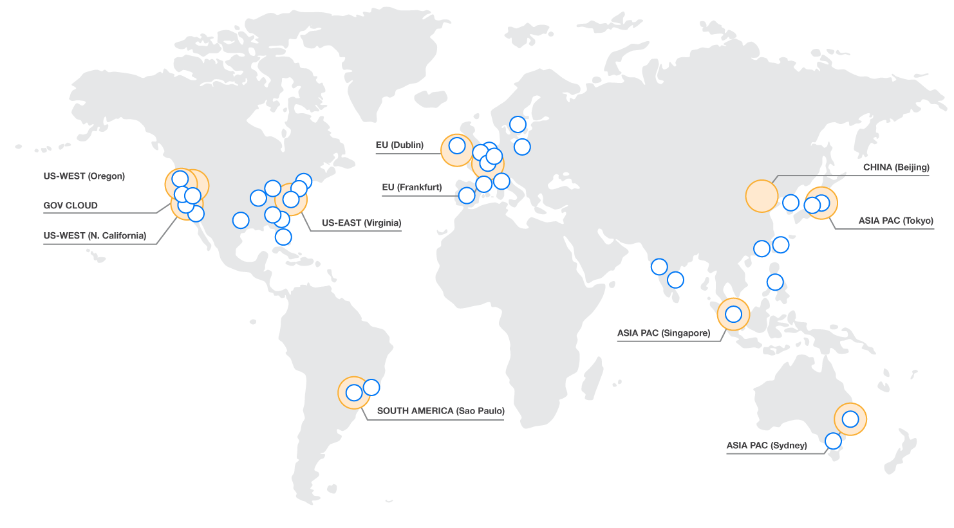
Region
AZ
Transit
Geographic area where AWS services are available
Customers choose region(s) for their AWS resources
Eleven regions worldwide
AZ
AZ
AZ
AZ
Transit

Slide 15
Availability Zone (AZ)
Each region has multiple, isolated locations known as Availability Zones
Low-latency links between AZs in a region <2ms, usually <1ms
When launching an EC2 instance, a customer chooses an AZ
Private AWS fiber links interconnect all major regions
REGION
EC2
AVAILABILITY ZONE 1
EC2
EC2
EC2
AVAILABILITY ZONE 2
AVAILABILITY ZONE 3

Slide 16
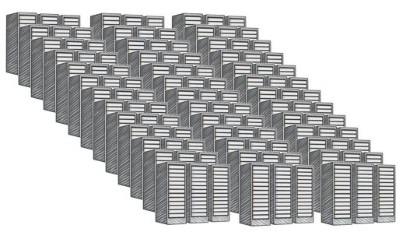
Example of Availability Zone (AZ)
AZ
Transit
AZ
AZ
AZ
AZ
Transit
Data Center
Data Center
1 of 28 AZs world-wide
All regions have 2 or more AZs
Each AZ is 1 or more DC
No data center is in two AZs
Some AZs have as many as 6 DCs
DCs in AZ less than ¼ ms apart
Data Center
Data Center

Slide 17


Virtual Private Cloud (VPC)
Logically isolated section of the AWS cloud, virtual network defined by the customer
When launching instances and other resources, customers place them in a VPC
All new customers have a default VPC
VPC
REGION
EC2
AVAILABILITY ZONE 1
AVAILABILITY ZONE 2
EC2
EC2
EC2
AVAILABILITY ZONE 3

Slide 18
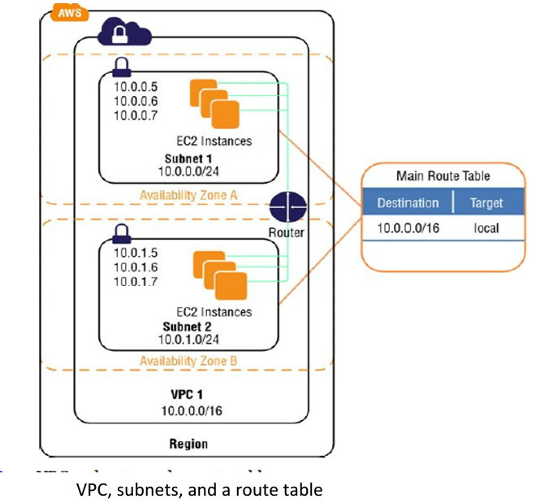
Virtual Private Cloud (VPC) contd.
A virtual private cloud (VPC) is a hybrid model of cloud computing in which a private cloud solution is provided within a public cloud provider’s infrastructure.
Private cloud: Amazon VPC, private cloud provider: Amazon web service.
• The Various aspects of a VPC are under your control:
IP address range, by choosing a CIDR blocks.
Your own subnets.
Configuring your own route tables
Network gateways
Security settings
EC2-classic and EC2– VPC: Versions of Vpc.
The assigned CIDR block of the VPC will be 172.31.0.0/16.

Slide 19
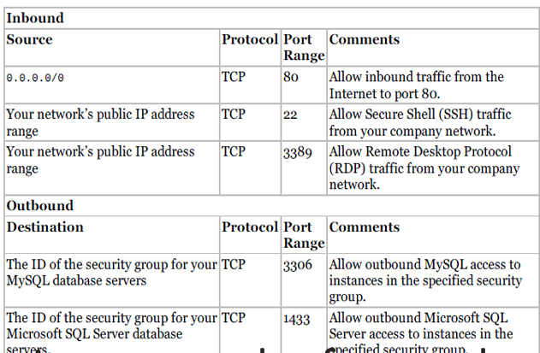
Security Groups
A security group is a virtual stateful firewall that controls inbound and outbound network traffic to AWS resources and Amazon EC2 instances.
All Amazon EC2 instances must be launched into a security group.
If not specified then they are configured with default security group.
The default security group allows communication between all resources within the security group
allows all outbound traffic, and denies all other traffic.
We can change the security group rules but cannot delete it
Security group rules for a web server

Slide 20

Amazon Elastic Compute Cloud (EC2)
A web service that provides resizable compute capacity in the cloud.
EC2 allows creating Virtual Machines (VM) on-demand. Pre-configured templated Amazon Machine Image (AMI) can be used get running immediately. Creating and sharing your own AMI is also possible via the AWS Marketplace.
Auto Scaling allows automatically scale of the capacity up seamlessly during demand spikes to maintain performance, and scales down during demand lulls to minimize costs.
Elastic Load Balancing automatically distributes incoming application traffic across multiple Amazon EC2 instances.
Provide tools to build failure resilient applications by launching application instances in separate Availability Zones.
Pay only for resources actually consume, instance-hours.
VM Import/Export enables you to easily import virtual machine images from your existing environment to Amazon EC2 instances and export them back at any time.

Slide 21
Amazon Elastic Compute Cloud (EC2) contd.
Free Usage Tier
On-Demand Instances
Start and stop instances whenever you like, costs are rounded up to the nearest hour. (Worst price)
Reserved Instances
Pay up front for one/three years in advance. (Best price)
Unused instances can be sold on a secondary market.
Spot Instances
Specify the price you are willing to pay, and instances get started and stopped without any warning as the marked changes. (Kind of like Condor!)

Slide 22
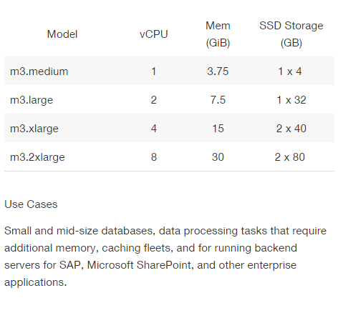
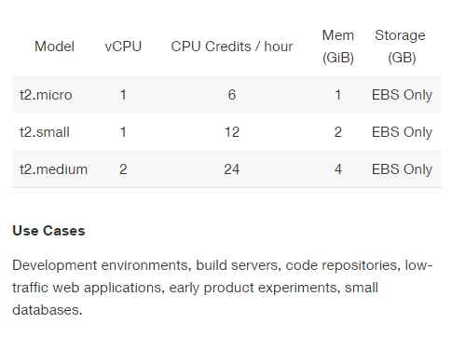
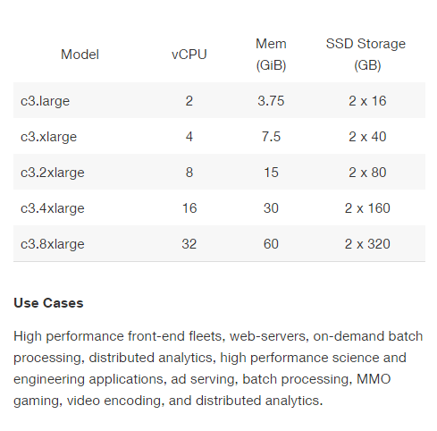
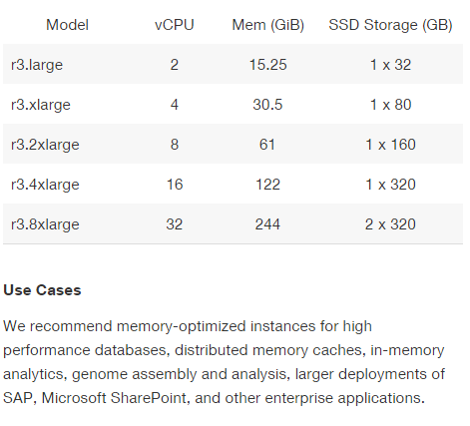
Amazon Elastic Compute Cloud (EC2) contd.

Slide 23
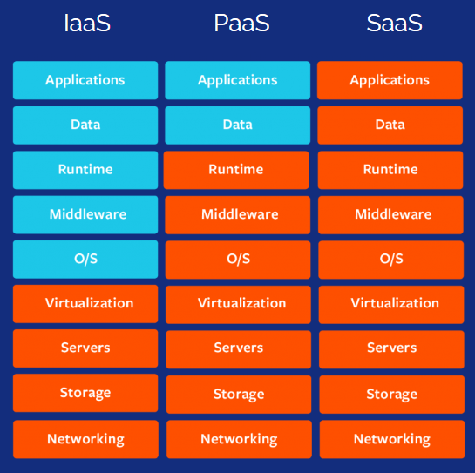
Cloud Computing Models
Infrastructure as a Service (IaaS)
Contains the basic building blocks for Cloud IT(EC2, VPC, EBS etc.)
Platform as a Service (PaaS)
AWS manages the underlying infrastructure(RDS, EMR, ElasticSearch)
Software as a Service (SaaS)
Completed product that is run and managed by service provider. Mostly refers to end-user applications. (Web-based Email, Office 365,Salesforce.com etc..)

Slide 24
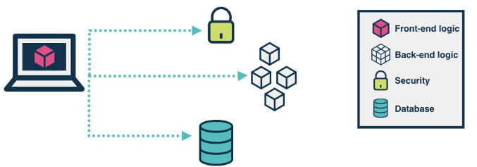
Serverless Computing
Allows you to build and run applications and services without thinking about servers.
Also referred to as Function-as-a-Service (FaaS) or Abstracted Services.
Examples:
Amazon Simple Storage Service (S3)
AWS Lambda
Amazon Dynamo DB
Amazon SNS

Slide 25
AWS Storage Portfolio
Different storage services offered by AWS

Slide 26
The AWS storage portfolio
Amazon S3
Object storage: data presented as buckets of objects
Data access via APIs over the Internet
Amazon Elastic Block Store
Block storage (analogous to SAN): data presented as disk volumes
Lowest-latency access from single Amazon EC2 instances
Amazon Glacier
Archival storage: data presented as vaults/archives of objects
Lowest-cost storage, infrequent access via APIs over the Internet
Amazon EFS
File storage (analogous to NAS): data presented as a file system
Shared low-latency access from multiple EC2 instances

Slide 27

Amazon Simple Storage Service (S3)
Amazon S3 provides a simple web services interface that can be used to store and retrieve any amount of data, at any time, from anywhere on the web.
Write, read, and delete objects containing from 1 byte to 5 terabytes of data each. The number of objects you can store is unlimited.
Each object is stored in a bucket and retrieved via a unique, developer-assigned key.
A bucket can be stored in one of several Regions.
You can choose a Region to optimize for latency, minimize costs, or address regulatory requirements.
Objects stored in a Region never leave the Region unless you transfer them out.
Authentication mechanisms are provided to ensure that data is kept secure from unauthorized access.
Objects can be made private or public, and rights can be granted to specific users.
S3 charges based on per GB-month AND per I/O requests AND per data modification requests.

Slide 28
Amazon Elastic Block Store (EBS)
Provides block level storage volumes (1 GB to 1 TB ) for use with Amazon EC2 instances.
Multiple volumes can be mounted to the same instance.
EBS volumes are network-attached, and persist independently from the life of an instance.
Storage volumes behave like raw, unformatted block devices, allowing users to create a file system on top of Amazon EBS volumes, or use them in any other way you would use a block device (like a hard drive).
EBS volumes are placed in a specific Availability Zone, and can then be attached to instances also in that same Availability Zone.
Each storage volume is automatically replicated within the same Availability Zone.
EBS provides the ability to create point-in-time snapshots of volumes, which are persisted to Amazon S3.
These snapshots can be used as the starting point for new Amazon EBS volumes, and protect data for long-term durability.
The same snapshot can be used to instantiate as many volumes as you wish.
These snapshots can be copied across AWS regions.
**EBS is approx. 3x more expensive by volume and 10x more expensive by IOPS than S3.

Slide 29
Amazon Elastic File System
1/2
Fully managed file system for EC2 instances
Provides standard file system semantics
Works with standard operating system APIs
Sharable across thousands of instances
Elastically grows to petabyte scale
Delivers performance for a wide variety of workloads
Highly available and durable
NFS v4–based

Slide 30



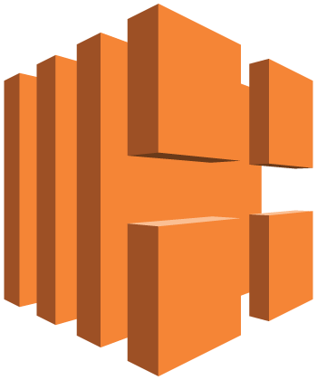




AWS Tier Scalable Web Application Architecture in 1 Zone
www.example.com
media.example.com
Amazon Route 53
CloudFront
distribution
web app
server
root volume
logs
Elastic Load Balancing
EC2 instance
security group
data volume
Amazon EBS snapshot
Amazon S3 bucket
Auto Scaling group
security group
Availability Zone #1

Slide 31
AWS Database
Persistent Database Service by AWS

Slide 32

Amazon Relational Database Service (RDS)
Amazon RDS is a web service that makes it easy to set up, operate, and scale a relational database in the cloud.
Amazon RDS gives access to the capabilities of a familiar MySQL, Oracle or Microsoft SQL Server database engine.
Code, applications, and tools already used with existing databases can be used with RDS.
Amazon RDS automatically patches the database software and backs up the database, storing the backups for a user-defined retention period and enabling point-in-time recovery.
Amazon RDS provides scaling the compute resources or storage capacity associated with the Database Instance.
Pay only for the resources actually consumed, based on the DB Instance hours consumed, database storage, backup storage, and data transfer.
On-Demand DB Instances let you pay for compute capacity by the hour with no long-term commitments.
Reserved DB Instances give the option to make a low, one-time payment for each DB Instance and in turn receive a significant discount on the hourly usage charge for that DB Instance.

Slide 33

Amazon DynamoDB
DynamoDB is a fast, fully managed NoSQL database service that makes it simple and cost-effective to store and retrieve any amount of data, and serve any level of request traffic.
All data items are stored on Solid State Drives (SSDs), and are replicated across 3 Availability Zones for high availability and durability.
DynamoDB tables do not have fixed schemas, and each item may have a different number of attributes.
DynamoDB has no upfront costs and implements a pay as you go plan as a. a flat hourly rate based on the capacity reserved.
NoSQL Databases
A NoSQL database provides a mechanism for storage and retrieval of data that employs less constrained consistency models than traditional relational databases.
NoSQL databases only support Eventual Consistency which is a consistency model used in distributed computing that informally guarantees that, if no new updates are made to a given data item, eventually all accesses to that item will return the last updated value.
NoSQL databases are often highly optimized key–value stores intended for simple retrieval and appending operations, with the goal being significant performance benefits in terms of latency and throughput.
Key–value stores allow the application to store its data in a schema-less way.
The data could be stored in a datatype of a programming language or an object. Because of this, there is no need for a fixed data model.

Slide 34
AWS Other Services
Most used services

Slide 35

Amazon CloudWatch
Amazon CloudWatch provides monitoring for AWS cloud resources and the applications customers run on AWS.
Amazon CloudWatch lets you programmatically retrieve your monitoring data, view graphs, and set alarms to help you troubleshoot, spot trends, and take automated action based on the state of your cloud environment.
Amazon CloudWatch enables you to monitor your AWS resources up-to-the-minute in real-time, including:
Amazon EC2 instances,
Amazon EBS volumes,
Elastic Load Balancers,
Amazon RDS DB instances.
Metrics such as CPU utilization, latency, and request counts are provided automatically for these AWS resources.
Customers can also supply their own custom application and system metrics, such as memory usage, transaction volumes, or error rates,.

Slide 36
DevOps help?
Suggestions

Slide 37
Unexpected Costs?
When you finish your work remember to make sure of the following to avoid unwanted costs:
Delete your S3 objects.
Stop or Shut Down your EC2 and RDS instances.
Request for Temp EC2 instances
Move to Serverless Architecture
For Machine Learning and AI use Sagemaker, Redshift, Kinesis etc
Send your custom logs to cloudwatch and request for access for dashboard
The customer is responsible for the resources he’s using. AWS declines any responsibility if the customer forgets to shut down resources.

Slide 38



So What Does A Modern App Look Like?
How you run and interact with it
How it integrates
How you monitor it

Slide 39
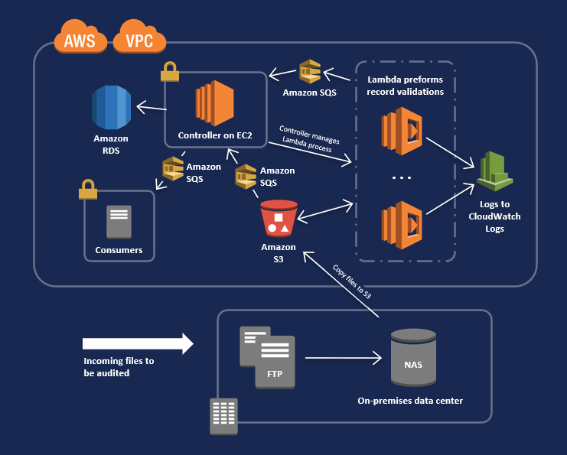
AWS Tier Example of an Application with SQS

Slide 40
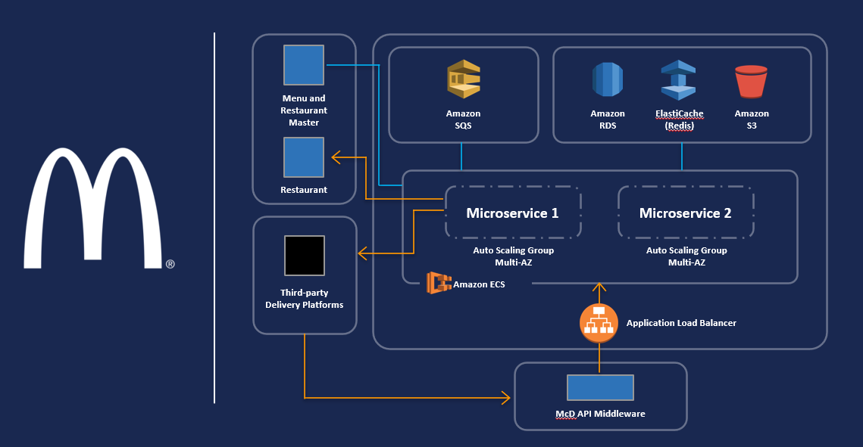
AWS Tier Example of McDonalds App

Slide 41
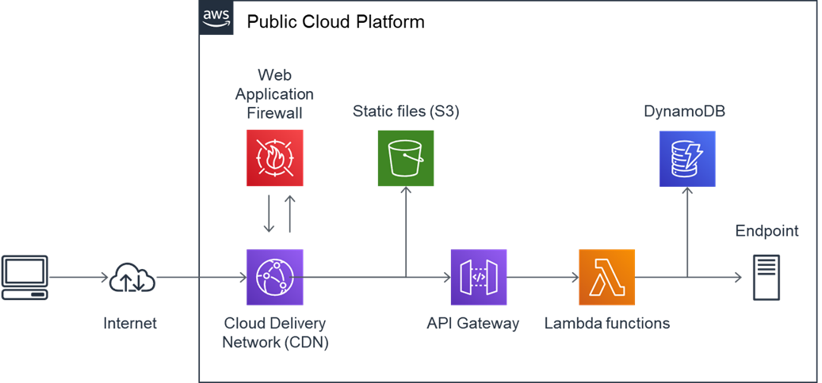
AWS Serverless

Slide 42
Is AI just coding & scripts?
No!

Slide 43
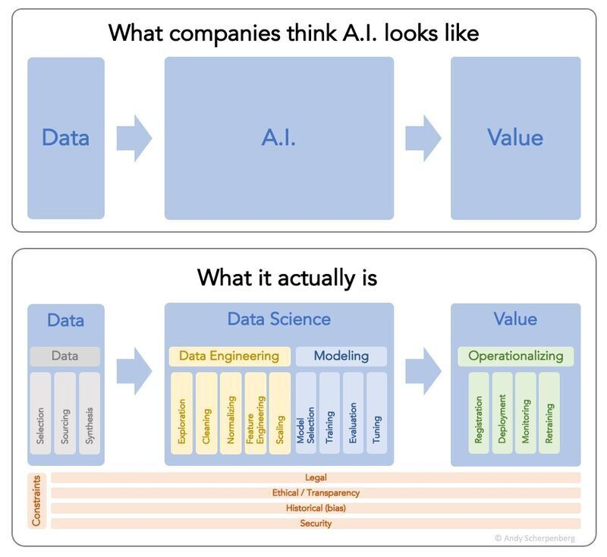

Slide 44









Slide 45
Questions?
Thank you!
- Austin Noronha Technical Architect, Accrete.ai https://in.linkedin.com/company/accreteai

